Slide 1
Sharing Experience Deploy Python Flask App in pythonanywhere.com
By (Ping) Nalongsone Danddank ICS 499

Slide 2
Before Start deploy
I assume that you guys all already familiar with Linux command line and Git.
Your project is working on github your account already.
Then, go to register on pythonanywhere.com for a free account.
your username on pythonanywhere.com will be your URL.
example: username is “tordle” -> “tordle.pythonanywhere.com”

Slide 3
Prepare your project in Virtual Environment
make sure you code is running well in your local machine and Synchronize with your github repository.
If your python flask project is developing in “PyCharm” IDE, your project should working on virtual environment, you could see “venv” folder in your IDE.
if not, I recommand install “virtualenv” package by pip and using python version that you like, then install all packages into the virtual environment which you need for your project .
More detail, just search on google how to use python and work with “virtualenv”.
then check and run well your project in the virtualenv.

Slide 4
Prepare project requirement install list
Remember Python version that use on your local machine that work in virtual environment
Use pip command line: “pip freeze > requirements.txt” to list all packages that require for your project.
Don't forget synchronize your code in local to Github repository.

Slide 5
Work on pythonanywhere web consoles 1
go to the website -> Consoles -> Start a Bash console
then, in Linux of the website there should install a lot tools, package of python already, but it may still need more for our project.
you may check if virtualenv package is install in Linux or not by command line “pip list” to see the package.
using git clone to clone your project of your github repository.
“git clone https//github.com/username/yourproject.git”
next, cd in your folder project : “cd yourfolder”

Slide 6
Work on pythonanywhere web consoles 2
then create the virtual environment for your project in Linux of website.
-> “ mkvirtualenv myenv --python='/usr/bin/python3.9' ” :
“myenv” is folder virtual environment name. (in your local machine or Pycharm IDE, the folder should name “venv”)
--python='/.../../' mean set python version to 3.9 and for you, you need to set python version that same with your local machine.
Linux system will get in the virtual environment after create it.
then, in your project folder install all requirements list
-> “pip install -r requirements.txt” ... and wait for it done for install everythings.

Slide 7
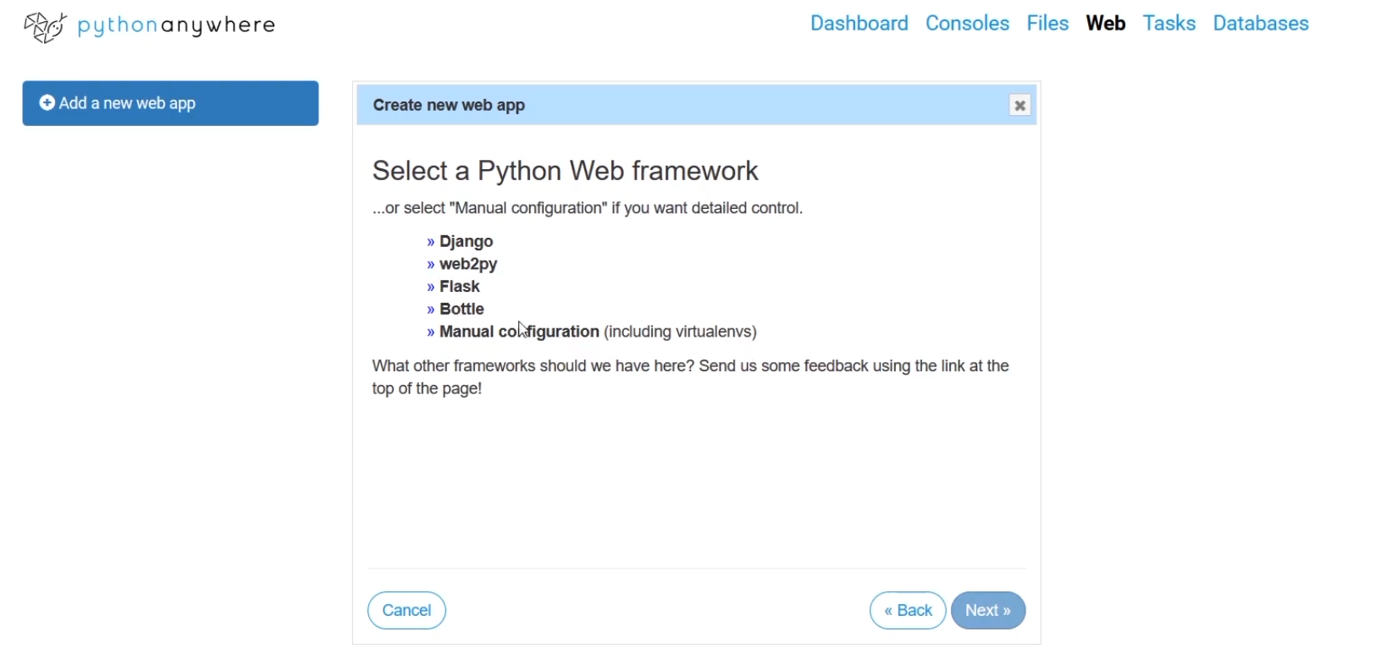
Work on pythonanywhere create web app 1
then turn to click the “web” link to page that let you choice.
you could choice Flask, but I like to choice Manual configuration to create new web app.

Slide 8
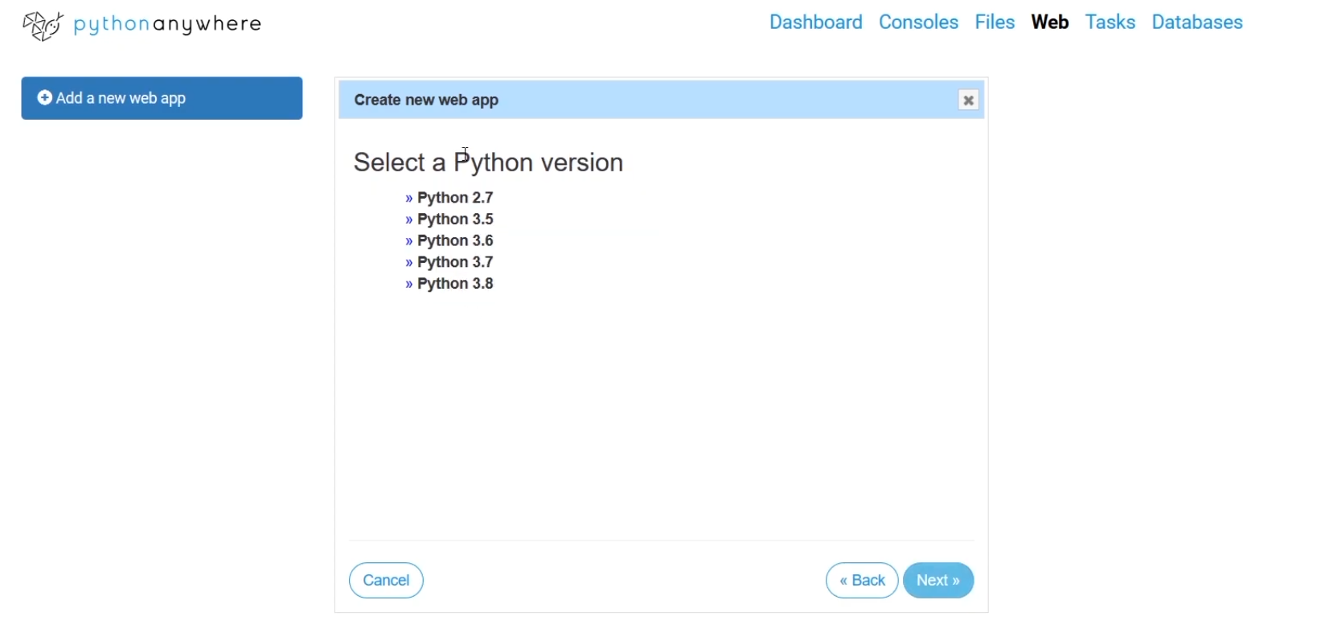
Work on pythonanywhere create web app 2
then select Python version that match to your project.
and click next util finish.

Slide 9
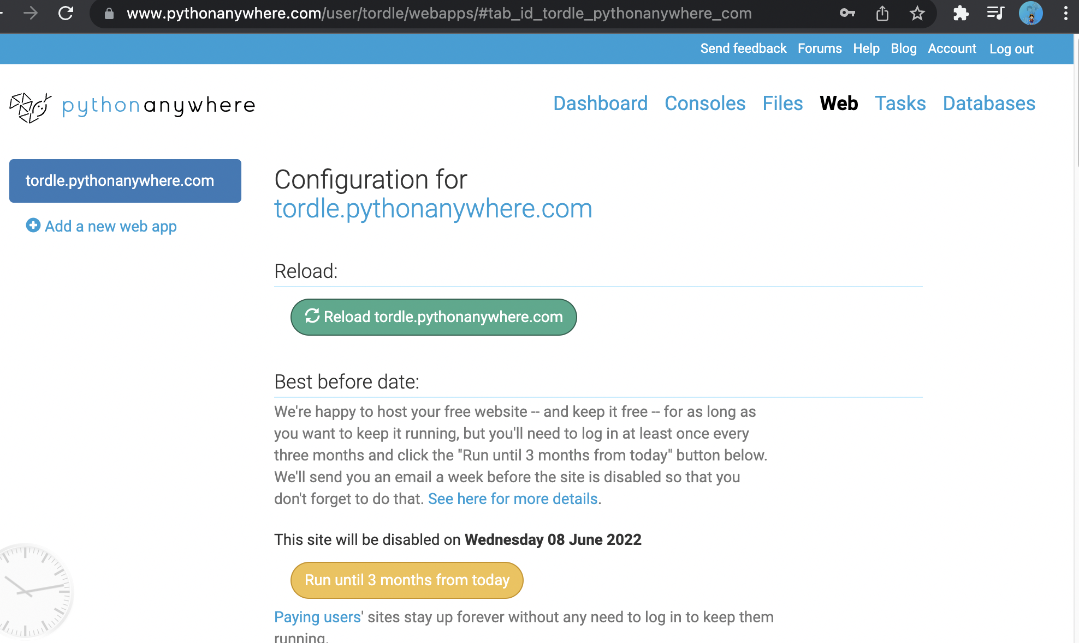
Work on pythonanywhere create web app 3
then we can see the page like:

Slide 10
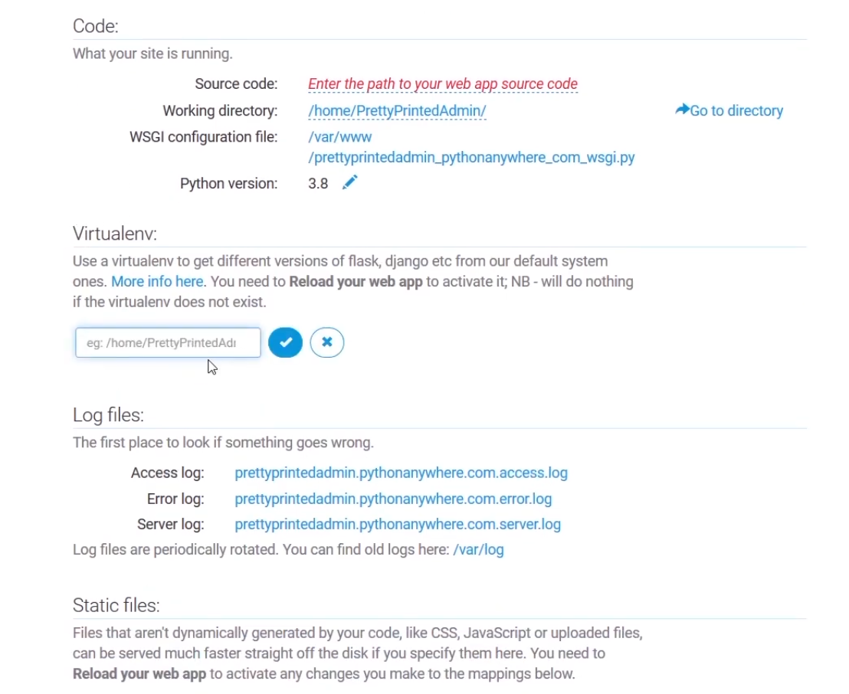
Work on pythonanywhere create web app 4
- Under Virtualenv type the path of your virtual environment.
- Then under “Code:” enter the path of you project app source oce to “Source code: “
- Finally, click on the link:
“WSGI configuration file: /var/www
/...........py”

Slide 11
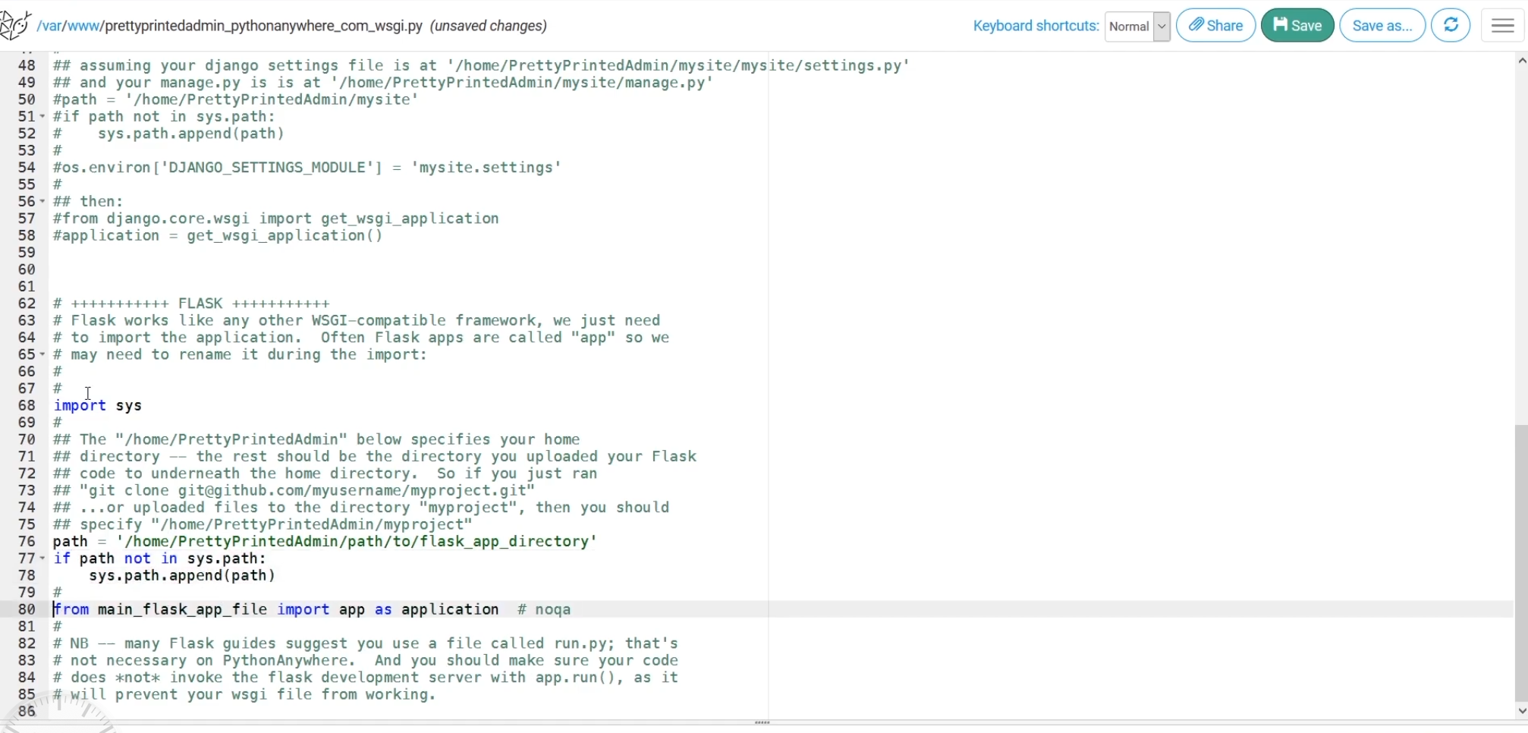
Work on pythonanywhere create web app 5
- After click on the link we can see this page:
- then, uncomment to use the python code like below:
“import sys”
“path = '/home/...”
“if path not....
sys.....”
“from main_f.....”

Slide 12
Work on pythonanywhere create web app 6
- then we change the path on line 76 to your project path:
- Example: path = '/home/username/project_directory'
- on line 80, change main_flask_app to the file name that you run your app like main from “main.py” .
- and on the same line that
“import app as application”the
“app” should be the same as
you write in your main.py file.
- Finally, save your code and
click on Reload button.

Slide 13
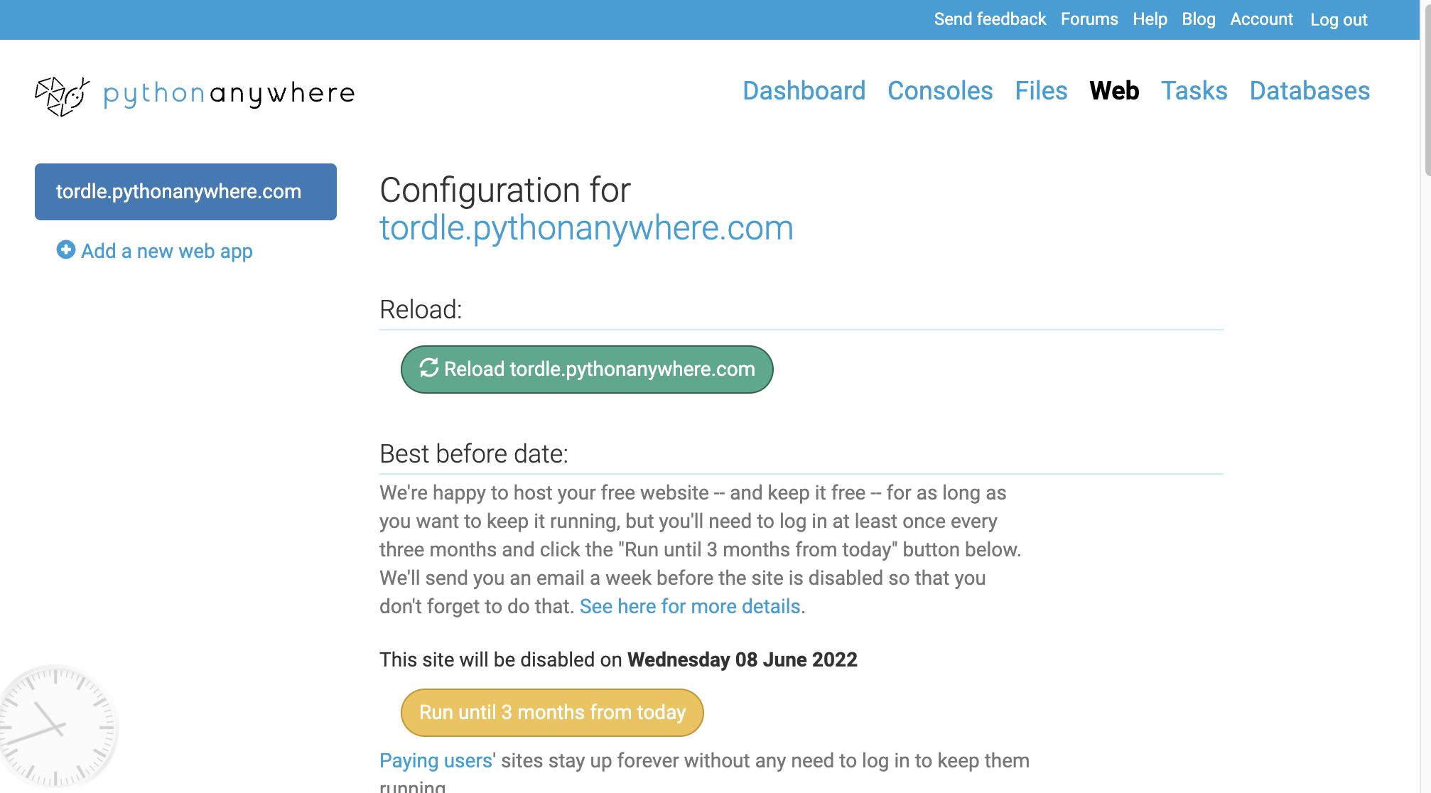
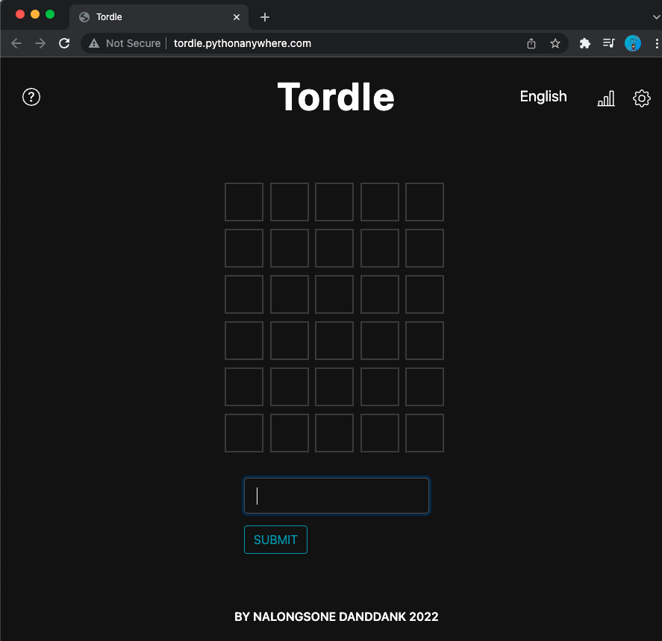
Work on pythonanywhere create web app 7
- After, Reload, come back to Web page and click on your web link:
for mine is tordle.pythonanywhere.com then you could see your web page which you build.

Slide 14
Good Luck!
By Nalongsone Danddank.
email: nalongsone.danddank@my.metrostate.edu

